Slide 1
STM32 – TOOLS.
Micro101

Slide 2
Tools Overview
Overview Portfolio
Evaluation Boards
Free IDEs
AC6
CoIDE
Keil (M0/M0+)
mbed
Ecosystem
STM32CubeMX
STLink Utility
ST Visual Programmer (STVP)
STM32 Flash Loader Demonstrator
Dfuse
STM Studio

Slide 3









ST has licensed all Cortex®-M cores
Forget traditional 8/16/32-bit classifications and get
Seamless architecture across all applications
Every product optimized for ultra-low power and ease of use
Cortex-M0/M0+
Cortex-M3
Cortex-M4
Cortex-M7
MCU
8/16-bit applications
16/32-bit applications
16/32-bit DSC applications
16/32-bit DSC applications
Binary and tool compatible
Notes:
ST is a leading partner with ARM for Cortex-M cores, participating in the definition of these cores. Today, the STM32 portfolio includes [CLICK] the full panel of Cortex-M cores, from the Cortex-M0 and Cortex-M3 to the Cortex-M4. The portfolio offers more than 300 devices in full production.

Slide 4
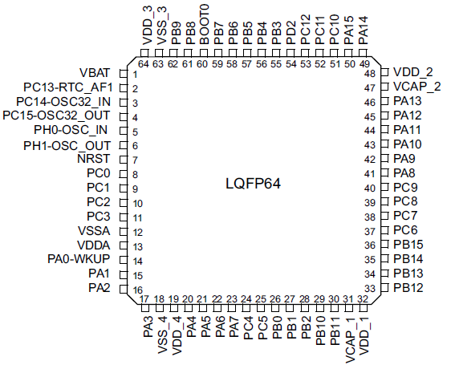
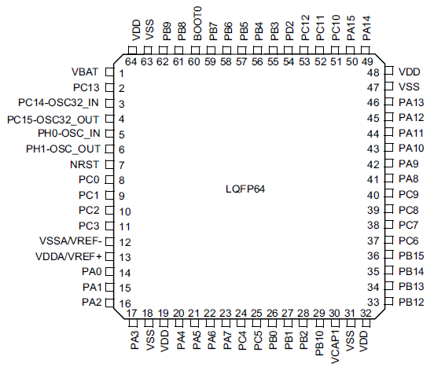


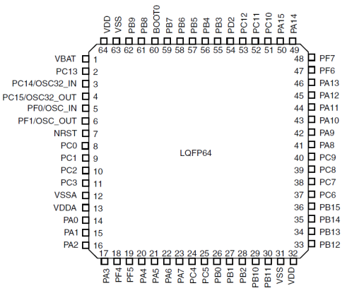
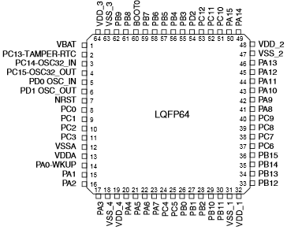
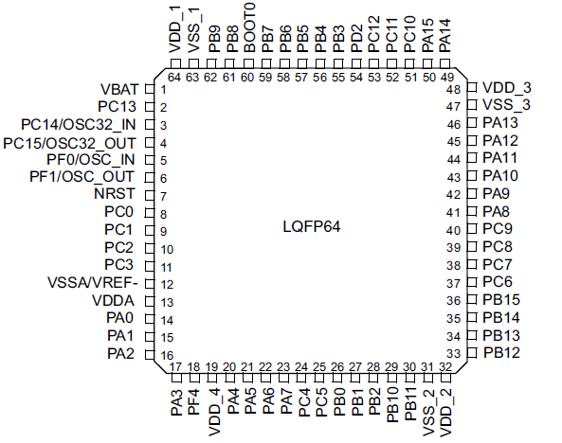
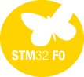


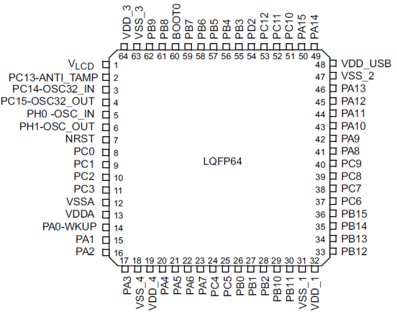
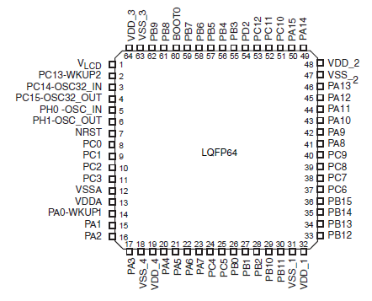
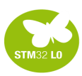
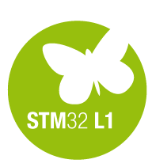
STM32 pin-to-pin compatibility(ex: LQFP64 )
Performance
Energy Efficiency
Mainstream
Over 550 pin-to-pin compatible devices
Ultra-low-power
CortexTM-M0/0+
CortexTM-M3
CortexTM-M4

Slide 5
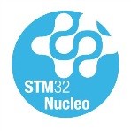
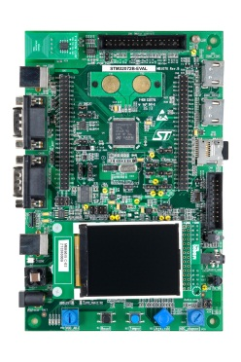
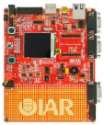
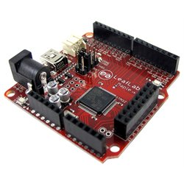
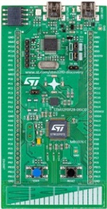
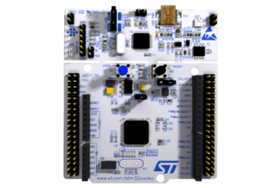
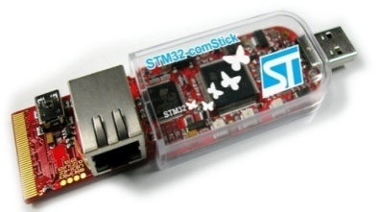

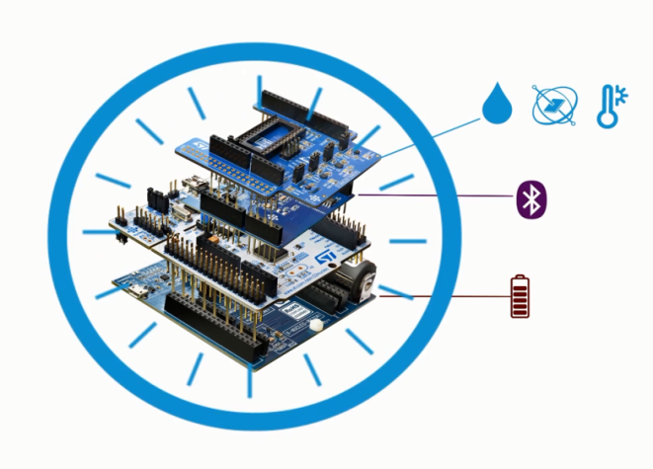







Broad Range of Development Tools
STM32 Nucleo
Discovery kits
Evaluation boards
3rd parties
Flexible prototyping
Key feature prototyping
Full feature evaluation
From full evaluation to open hardware
www.st.com/stm32nucleo
www.st.com/stm32discovery
STM32 Nucleo expansion boards
Specialized functionality add-on
Connectivity, Sensors…
www.st.com/x-nucleo
Notes:
Various types of development boards enable you to get started with the STM32 microcontrollers.
* The STM32 Nucleo boards provide an affordable and flexible way for anyone to try out new ideas and build prototypes with a wide choice of specialized expansion boards.
* The Discovery kits enable users to seamlessly exercise key features of STM32 products, while the Evaluation board exposes all MCU functionalities.
All these development boards include an integrated debugger/programmer as well as a comprehensive software library with examples that help developers to take davantage of STM32 capabilities.

Slide 6
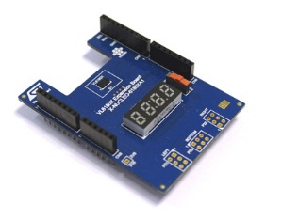
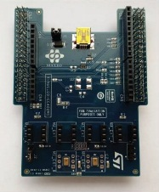
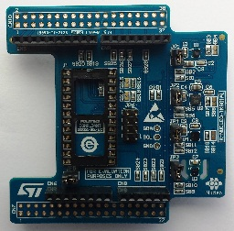
STM32 ODE
STM32 X-Nucleo Portfolio
Sensors Expansion Boards
Part Number | Marketing Status | Core Product | General Description
P-NUCLEO-6180X1 | Active | VL6180X | VL6180X Nucleo pack - NEW - Includes VL6180X Expansion board and STM32F401RE Nucleo
P-NUCLEO-6180X2 | Active | VL6180X | VL6180X Nucleo pack - NEW - Includes VL6180X Expansion board and STM32L053R8 Nucleo
X-NUCLEO-6180XA1 | Active | VL6180X | Proximity and ambient light sensor expansion board based on VL6180X for STM32 Nucleo
X-NUCLEO-CCA02M1 | Active | MP34DT01-M | Digital MEMS microphones expansion board based on MP34DT01-M for STM32 Nucleo
X-NUCLEO-IKS01A1 | Active | LSM6DS0; LIS3MDL; LPS25HB; HTS221 | Motion MEMS and environmental sensor expansion board for STM32 Nucleo
Proximity
Motion MEMS
Environmental Sensors
MEMS Microphones

Slide 7
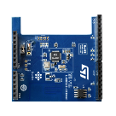
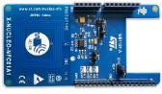
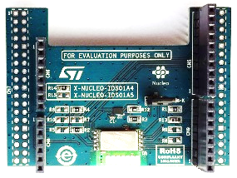
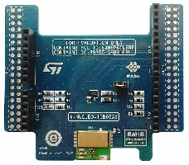
STM32 ODE
STM32 X-Nucleo Portfolio
Connectivity Expansion Boards
Part Number | Marketing Status | Core Product | General Description
X-NUCLEO-IDB04A1 | Active | BlueNRG; BALF-NRG-01D3 | Bluetooth low energy expansion board based on BlueNRG for STM32 Nucleo
X-NUCLEO-IDB05A1 | Evaluation | SPBTLE-RF;BlueNRG-MS;BALF-NRG-01D3 | Bluetooth Low Energy expansion board based on SPBTLE-RF module for STM32 Nucleo
X-NUCLEO-IDS01A4 | Active | SPSGRF-868 | Sub-1 GHz RF expansion board based on the SPSGRF-868 module for STM32 Nucleo
X-NUCLEO-IDS01A5 | Active | SPSGRF-915 | Sub-1 GHz RF expansion board based on the SPSGRF-915 module for STM32 Nucleo
X-NUCLEO-NFC01A1 | Active | M24SR64-YMN6T/2 | Dynamic NFC tag expansion board based on M24SR for STM32 Nucleo
Bluetooth Smart
SubGhz
NFC

Slide 8
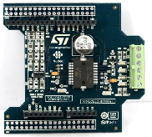
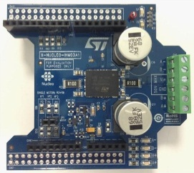
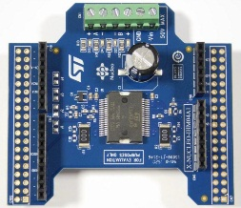
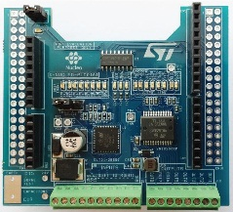
STM32 ODE
STM32 X-Nucleo Portfolio
Motor Control Expansion Boards
Part Number | Marketing Status | Core Product | General Description
X-NUCLEO-IHM01A1 | Active | L6474PD | Stepper motor driver expansion board based on L6474 for STM32 Nucleo
X-NUCLEO-IHM03A1 | Active | powerSTEP01 | High power stepper motor driver expansion board based on powerSTEP01 for STM32 Nucleo
X-NUCLEO-IHM04A1 | Active | L6206 | Dual brush DC motor driver expansion board based on L6206 for STM32 Nucleo
X-NUCLEO-IHM05A1 | Active | L6208 | Bipolar stepper motor driver expansion board based on L6208 for STM32 Nucleo
Stepper Motors
Brush DC
NFC
Input-Output Expansion Boards
Part Number | Marketing Status | Core Product | General Description
X-NUCLEO-PLC01A1 | Active | CLT01-38SQ7;VNI8200XP | Industrial input/output expansion board based on VNI8200XP and CLT01-38SQ7 for STM32 Nucleo

Slide 9
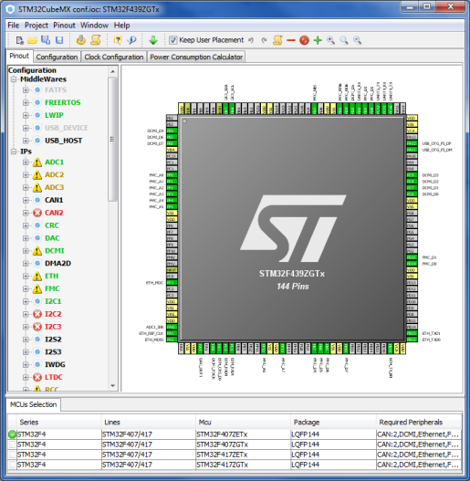
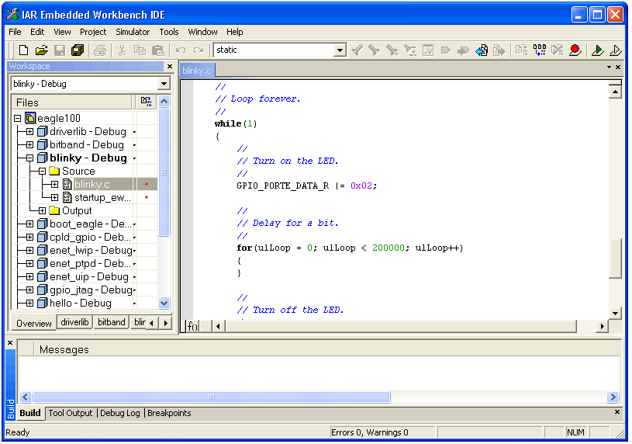
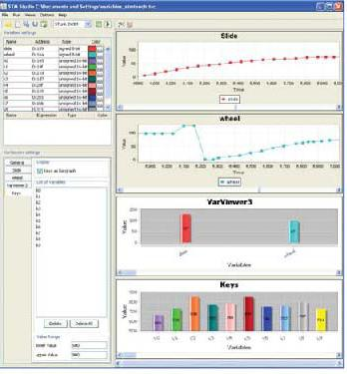
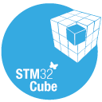
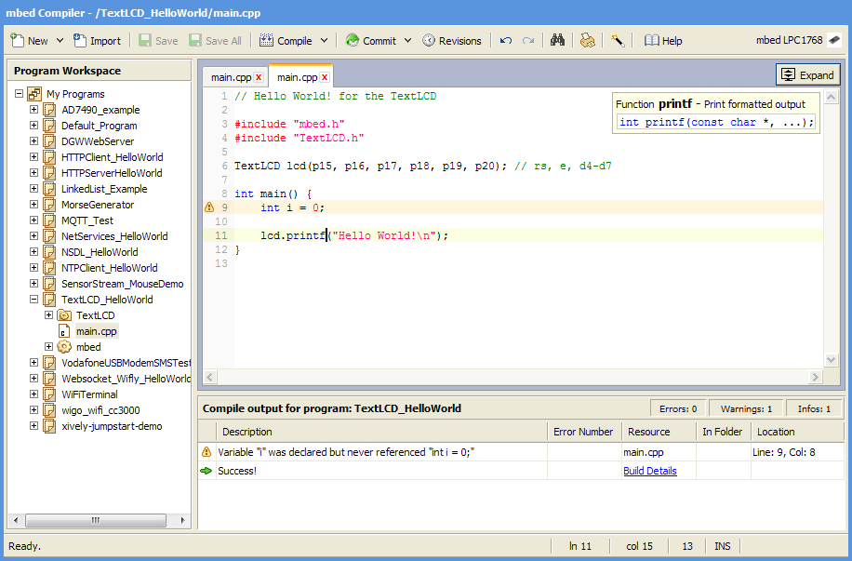
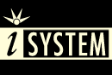







Comprehensive choice of IDEs
STM32CubeMX
Partners IDEs
STMStudio
Generate Code
Compile & Debug
Monitor
Free IDE

Slide 10
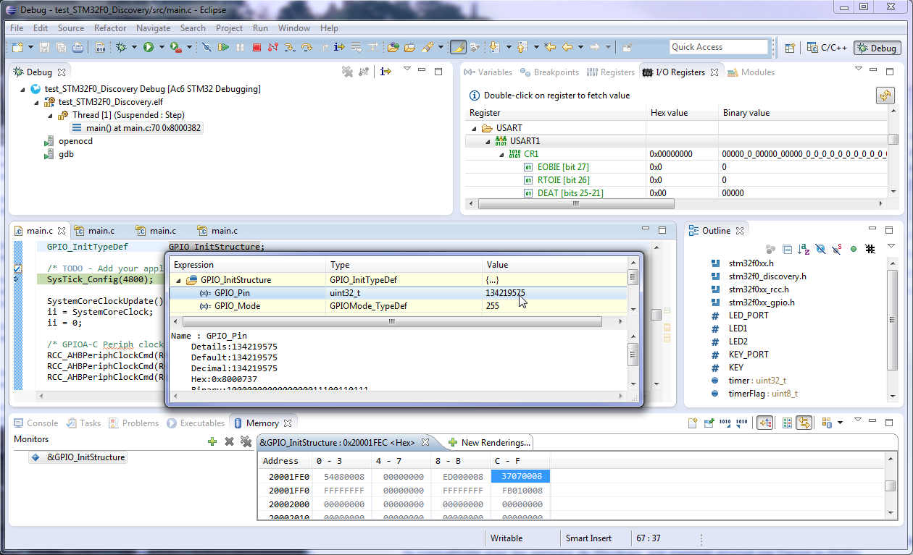
System Workbench for STM32
Free Eclipse-based flexible software development environment :
Covers the full range of STM32 mcus and associated boards (Nucleo, Discovery, Eval).
Comprehensive support for STM32 firmware (Standard Peripheral library or Cube HAL).
Customisation enabled through Eclipse plug-ins (SVN, EGit…).
Key features :
GCC C/C++ compiler.
GDB-based debugger.
ST-Link support.
Multi-OS support : Windows, Linux & OSX (Q2’2015).
No code size limit.
SW4STM32 project format will be supported by CubeMX.

Slide 11
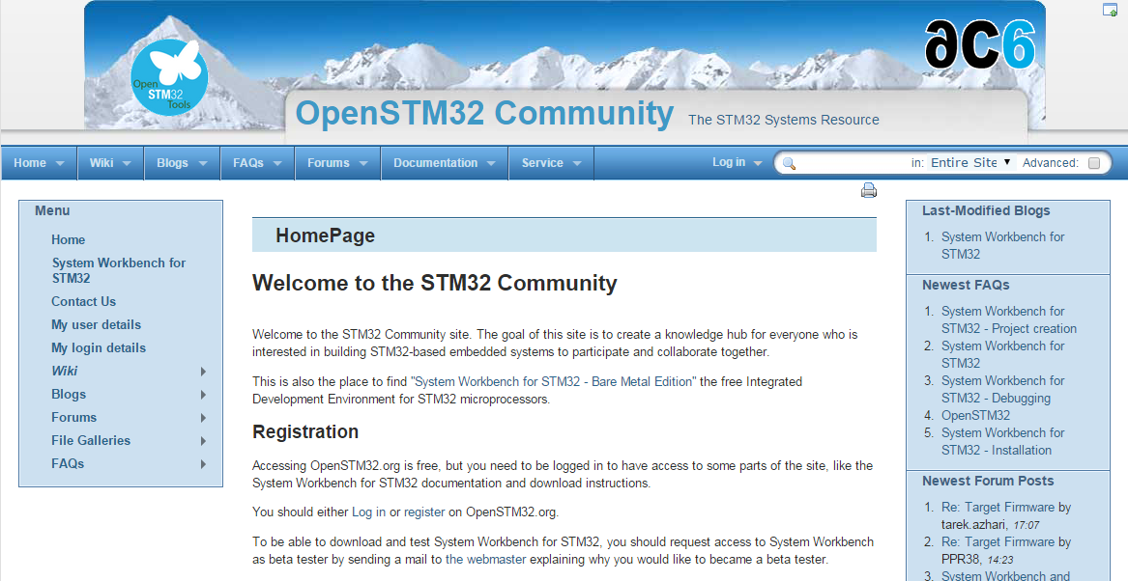
System Workbench for STM32
How to download SW4STM32 ?
Go to associated collaborative site at www.openstm32.org
Register to this site.
Get installation instructions at the Documentation > System Workbench page.
Proceed with immediate download of the toolchain.
Technical support :
Handled through the associated Openstm32 website.
Documentation, forum, blog, trainings are available to provide assistance to users.

Slide 12
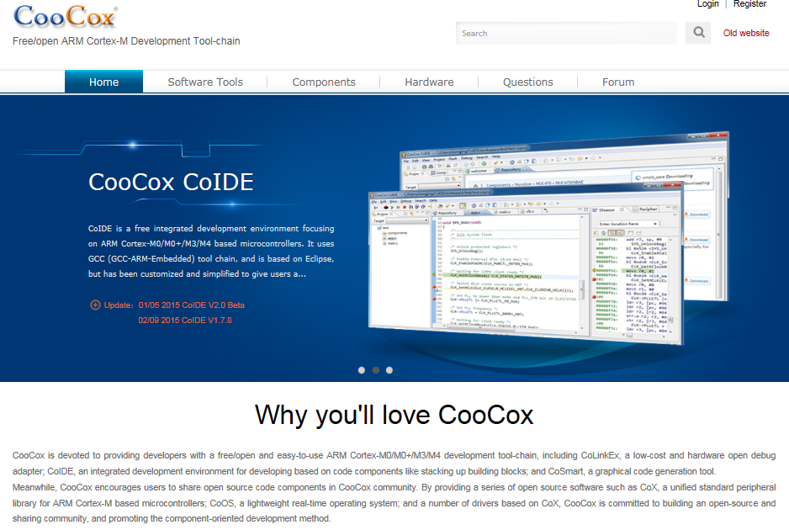
CoIDE
Free Eclipse-based simplified software development environment:
Supports all STM32 mcus and Nucleo boards.
Supports STM32Cube firmware (HAL).
Download and Technical support available through collaborative site at www.coocox.org
Key features :
GCC C/C++ compiler.
GDB-based debugger.
No code size limit.
ST-Link support.
English and Chinese languages are supported.

Slide 13

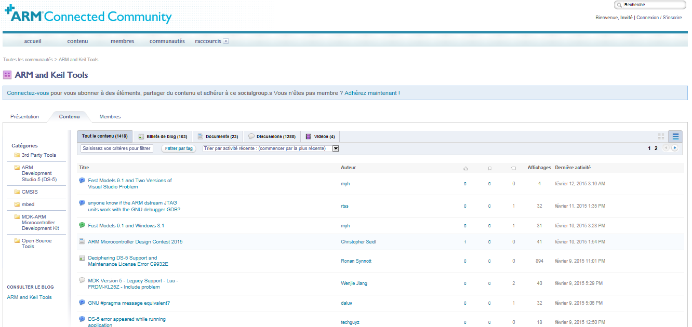
MDK-ARM
Comprehensive software development environment for Cortex-M devices :
Free version for ST supports all STM32F0 and STM32L0 mcus and associated boards (Nucleo, Discovery, Eval).
Comprehensive support for STM32 firmware (Std Peripheral library or Cube HAL).
Technical support available through the ARM Connected Community site at community.arm.com
Key features :
ARM C/C++ compiler.
uVision IDE, debugger and simulation environment.
CMSIS-compliant.
ST-Link support.
English, Chinese, Japanese, Korean languages are supported.
The setup of peripherals configured by CubeMX is directly exported to MDK.

Slide 14
Free MDK-ARM for ST
Free licenses for STM32 devices based on Cortex-M0/M0+ cores :
Applicable immediately to all STM32F0 and STM32L0 mcus.
PC-locked multi-year licenses.
No code size limit.
Multiple language support.
Technical support included.
Direct download from Keil website :
No limit of number of downloads by customer.
Direct access to configuration files for STM32 and associated boards.
Free access to MDK-ARM periodic updates.
How to get free MDK-ARM licenses for STM32F0 and STM32L0 ?
Go to Keil website at : www.keil.com/mdk-st
Download MDK-ARM toolchain.
Activate the free license using this Product Serial Number (PSN) : U1E21-CM9GY-L3G4L

Slide 15



Comprehensive choice of STM32 free IDEs
System Workbench
CoIDE
MDK-ARM
Q2’2015
Q2’2015
Free licenses for all STM32 microcontrollers
Free licenses for STM32F0 & STM32L0
Free access to all STM32Nucleo users

Slide 16



STM32 Embedded Software Offer - Overview
Abstraction Level
Virtual Machines
With partners
.Net, Java
IS2T, Oracle, Mountainer, .…
Mbed Core
« C » partners
Micrium, SEGGER,
HCC, ….
STM32Cube
Standard Peripheral Libraries
STM32Snippets
Portability Level
STM32 Device
-specific
f.i.: STM32F072
STM32 Series
-specific
f.i.: STM32F1
STM32 Family
-specific
Cortex-M based
MCUs
-specific
Any MCU
Beyond MCU
world
ST Offering. Free
Partners Offer

Slide 17

STM32Snippets
What is it ?
A collection of code examples, directly based on STM32 peripheral registers, available in documentation and as software bundles
Target Audience
low level embedded system developers, typically coming from an 8 bit background, used to assembly or C with little abstraction
Features:
Highly Optimized
Register Level Access
Small code expressions
Closely follows the reference manual
Debugging close to register level
Limitations:
Specific to STM32 devices, not portable directly between series
Not matching complex peripherals such as USB
Lack of abstraction means developers must understand peripheral operation at register level
Available (today) on STM32 L0 and F0 series
Portability | Optimization (Memory & Mips) | Easy | Readiness | Hardware coverage
 | +++ |  |  | +

Slide 18

Standard Peripheral Libraries (SPL)
What is it ?
Collection of C Libraries covering STM32 peripherals
Target Audience
Embedded systems developers with procedural C background. All existing STM32 customer base prior to the STM32Cube launch, willing to keep same supporting technology for future projects, and same STM32 series.
Features:
Average optimization, fitting lots of situations
No need for direct register manipulation
100% coverage of all peripherals
Easier debugging of procedural code
Extensions for complex middleware such as USB/TCP-IP/Graphics/Touch Sense
Limitations:
Specific to certain STM32 series.
No common HAL API prevents application portability between series
Middleware libraries may not be unified for each series
Doesn’t support forward STM32 series starting with STM32 L0 and F7
Portability | Optimization (Memory & Mips) | Easy | Readiness | Hardware coverage
++ | ++ | + | ++ | +++

Slide 19
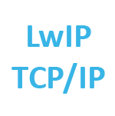


STM32Cube - Embedded software
What is it ?
Full featured packages with drivers, USB, TCP/IP, Graphics, File system and RTOS
Set of common application programming interfaces, ensuring high portability inside whole STM32 family
User code
STM32Cube
Middleware
STM32Cube
STM32 Hardware abstraction layer
Target Audience
Embedded system developers with a strong structured C background. New customers looking for a fast way to evaluate STM32 and easy portability
Features:
High level and functional abstraction
Easy port from one series to another
100% coverage of all peripherals
Integrates complex middleware such as USB/TCP-IP/Graphics/Touch Sense/RTOS
Can work with STM32CubeMX tool on the PC to generate initialization code
Limitations:
May be challenging to low level C programmers in the embedded space.
Higher portability creates bigger software footprints or more time spent executing adaptation code
Not Available (today) on STM32 F1 series
Portability | Optimization (Memory & Mips) | Easy | Readiness | Hardware coverage
+++ | + | ++ | +++ | +++

Slide 20
ST Embedded software offer – Comparison
Offer | Portability | Optimization (Memory & Mips) | Easy | Readiness | Hardware coverage
STM32Snippets |  | +++ |  |  | +
Standard Peripheral Library | ++ | ++ | + | ++ | +++
STM32Cube | +++ | + | ++ | +++ | +++

Slide 21
ST Embedded software offer - Positioning
Abstraction Level
Libraries, released independently
STM32Cube Embedded Software packages
STM32Cube Middleware level
TCP/IP
RTOS
TCP/IP
USB
Host / Device
Gfx
FAT
File
Sys.
RTOS
Touch
USB
Host / Device
FAT
File
Sys.
Touch
Gfx
STM32Cube HAL
(Hardware Abstraction Layer)
Standard Peripheral Libraries
STM32Snippets
Portability Level
STM32 Device
-specific
f.i.: STM32F072
STM32 Series
-specific
f.i.: STM32F1
STM32 Family

Slide 22

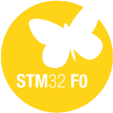

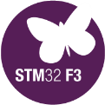



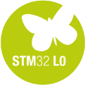


Availability
Offer | Available for STM32
STM32Snippets | Now | N.A. | N.A. | N.A. | N.A. | N.A. | Now | N.A. | N.A.
Standard Peripheral Library | Now | Now | Now | Now | Now | N.A. | N.A. | Now | N.A.
STM32Cube | Now | Now | Now | Now | Now | June 15 | Now | Now | Sept 15

Slide 23
STM32Cube Ecosystem

Slide 24

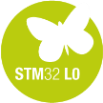

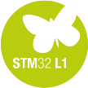
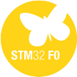
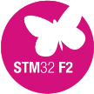

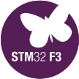
STM32CubeTM Introduction
24
STM32CubeTM includes:
A configuration tool, STM32CubeMX generating initialization code from user choices
Firmware offering, delivered per series (like STM32CubeF4) with:
An STM32 Abstraction Layer embedded software: STM32Cube HAL
A consistent set of Middleware: RTOS, USB, TCP/IP, Graphics, …
Initialization Code generation based on user choices
STM32CubeMX
STM32Cube HAL: Portable API within all series - Middleware stacks when applicable: RTOS, USB, TCP/IP, Graphics, …
STM32CubeL0
STM32CubeF4
STM32CubeL1
STM32CubeF0
STM32CubeF2
STM32CubeF1
STM32CubeF3

Slide 25
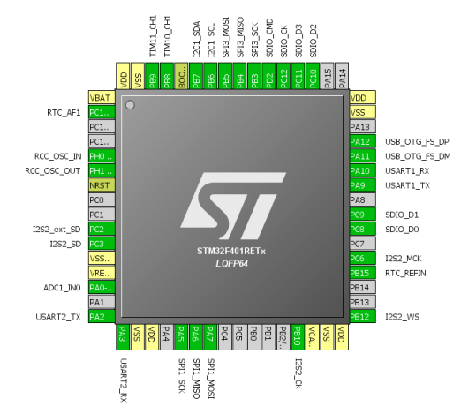
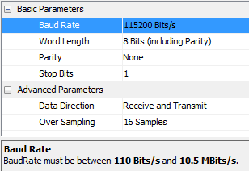




STM32CubeMX
25
Pinout Wizard
Peripherals & Middleware
Wizard
Power Consumption
Wizard
Clock Tree wizard

Slide 26


STM32CubeMX
26
Generates Initialization C Code
based on user choices !

Slide 27

STM32CubeMX: MCU Selector
Filter by:
Series
Line
Package
Peripherals

Slide 28

STM32CubeMX: Pin-out configuration
Pinout from:
Peripheral tree
Manually
Automatic signal remapping
Management of dependencies between peripherals

Slide 29

STM32CubeMX: Clock tree
Immediate display of all clock values
Management of all clock constraints
Highlight of errors

Slide 30

STM32CubeMX: Peripheral configuration
Global view of used peripherals and middleware
Highlight of configuration errors
Manage:
GPIO
Interrupts
DMA

Slide 31

Power consumption calculator
Power step definitions
Battery selection
Creation of consumption graph
Display of
Average consumption
Average DMIPS
Battery lifetime

Slide 32

STM32Cube Supporting all STM32 MCUs
Generate your configuration code with the STM32Cube and you can focus on your added-value software !
4 configuration wizards: pinout, clock, peripherals & middleware, power consumption
Portable Hardware Abstraction layer, from series to others
Middleware with RTOS, USB, TCP/IP, File System, Graphics , Touch sensing…
www.st.com/stm32cube

Slide 33
STM32 ST-LINK Utility

Slide 34


STM32 ST-LINK Utility
Standalone software tool allows in-system programming of STM32 devices
Supports Binary, Hex and Motorola S-Record file formats
Allows programming option bytes
Supports ST-LINK/V2
Command line version available for usage with batch files and small quantity production
ST-LINK_CLI.exe
Supports multiple ST-LINK/V2 connected to same PC
User manual UM0892

Slide 35
ST Visual Programmer

Slide 36

STVP
Free software that supports Motorola S19 and Intel HEX formats
Load, Edit and Save executable and/or data files generated by the Assembler/Linker or C compilers
Erase, Program, View and Verify device Flash memory contents
Project mode to automate all configuration and programming tasks
Programming Toolkit with C/C++ source files for creating a programming application based STVP
STVP supports microcontroller programming via a complete range of hardware development tools and dedicated programmers, including:
ST-LINK in-circuit debugger/programmer for STM8 and STM32

Slide 37
STM32 FLASH LOADER DEMONSTRATOR

Slide 38
FLASH LOADER DEMONSTRATOR
Illustrate the System Memory boot loader capabilities
The Flash loader demonstrator is designed to work with all STMicroelectronics devices that support the system memory boot mode UART protocol

Slide 39
DFUSE

Slide 40
DFUSE
Perform the upgrade operation with some requires, such as:
Product identifier
Vendor identifier
Firmware version
Alternate setting number (Target ID) of the target to be used,
These information makes the upgrade targeted and more secure.
To add this information, a new file format should be used, to be called DFU file format

Slide 41
STMSTUDIO

Slide 42
STMSTUDIO
STM Studio is a non-intrusive tool, preserving the real-time behavior of applications.
STM Studio perfectly complements traditional debugging tools to fine tune applications.
It is well suited for debugging applications which cannot be stopped, such as motor control applications.
Connects to any STM32 via ST-LINK (JTAG or SWD protocols), reads on-the-fly (non intrusive) variables from RAM while application is running

Slide 43
FOC SDK

Slide 44

STMSTUDIO
ST’s STM32 offers the performance of the industry-standard Cortex®-M core at the service of vector (or field-oriented) control (FOC) algorithms, widely used in high-performance drives.
The STM32 PMSM FOC SDK (STSW-STM32100), which includes the PMSM FOC FW library and ST MC Workbench, allows the user to evaluate the STM32 performance in applications driving single or dual Field Oriented

Slide 45













free SW licensing program
Unleashing the power of embedded software with algorithms and complete demonstrators for the Internet of Things.
Bring your ideas to now!
Notes:
This presentation will introduce the open.Audio free software licensing program.
Open.Audio is part of the ST Open Software Expansion initiative (OSX).
The Open Software Expansion (OSX) development suite offers drivers, middleware and application software to jump start your STM32 design with ST products like MEMS, Bluetooth low energy, environmental sensors, etc. It enables fast prototyping using the STM32 Open Development Environment with leading-edge components that can quickly be transformed into final designs.
The Open Software Expansion environment is made up of several free libraries:
• Open.MEMS: sensor fusion library for STM32 platform
• Open.RF: BlueNRG Bluetooth low energy library for the most commonly used BT smart profiles
• Open.Audio: embedded audio libraries and application software
It also includes implementation examples in the Open.Framework section. The BlueMicrosystem1 expansion software package uses a Bluetooth low energy (BlueNRG) network processor for communication and includes complete middleware to build applications using pressure, temperature and humidity sensors as well as motion sensors (MEMS).
Start your design today with our Open Software Expansion development suite.

Slide 46














STM32 ODE Nucleo and X-Nucleo
The building blocks
Your need
Our answer
Accelerometer, gyroscope
Sense
Inertial modules, magnetometer
DATA COLLECT
Pressure, temperature, humidity, UV
Proximity, microphone
Bluetooth LE, Sub-GHz radio
Connect
DATA TRANSMIT
NFC, Wi-Fi, GNSS
Audio amplifier
Translate
DATA ACCESS
Touch controller
Operation Amplifier
Stepper motor driver
Move / actuate
DATA CREATE
DC & BLDC motor driver
Power
DATA POWER
Energy management & battery
General purpose microcontrollers
Process
DATA PROCESS
STM32 Nucleo
Nucleo Expansion Boards
Secure microcontrollers
Software

Slide 47
STM32 M0 Overview
Cortex Architecture Overview
ARM Cortex Interrupt Overview
Debug System Overview

Slide 48
Architecture & Peripherals

Slide 49

System Architecture
Multiply possibilities of bus accesses to SRAM, Flash, Peripherals, DMA
BusMatrix added to allow parallel access
Efficient DMA and Rapid data flow
Direct path to SRAM through arbiter, guarantees alternating access
Von Neumann + BusMatrix allows Flash execution in parallel with DMA transfer
Increase Peripherals Speed for better performance
Advanced Peripheral bus (APB) architecture up to 48MHz
➔ Allows to optimize use of peripherals (18MBits/s SPI, 6Mbps USART, 48MHz GP-Timer, 12MHz toggling I/Os)
AHB
Flash I/F
Slave 3
FLASH
CORTEX-M0
Master 1
System
AHB
SRAM
Slave 1
Buses are not overloaded
with data movement tasks
BusMatrix
AHB
GPIO A, B ,C, D, E, F
GP-DMA
Master 2
DMA
AHB2GPIO
Slave 4 Bridge
AHB
RCC, CRC, Touch
Sensing controller (TSC)
AHB2APB
APB
SYSCFG, TIMs, WWD, IWWD, RTC,
I2Cs, USARTs, SPI/I2Ss, HDMI-CEC,
BxCAN, USB, DBGMCU
Arbiter
Slave 2 Bridges
Notes:
Several AHB subsystems
Dedicated AHB to GPIO
Each peripheral can be reset independently on APB

Slide 50
Boot Modes
50
Boot modes
Depending on the Boot configuration, Embedded Flash memory, System memory or Embedded SRAM memory
is aliased at @0x00. Even when aliased, these memories are still accessible from their original memory space.
The boot configuration is defined with BOOT0 pin, nBOOT1 bit, nBOOT0 bit and BOOT_SEL bit from USER option byte.
BOOT Mode Selection |  |  |  | Boot Mode | Aliasing
nBOOT1 bit | BOOT0 pin | BOOT_SEL bit | nBOOT0 bit
X | 0 | 1 | X | User Flash | User Flash is selected as boot space
1 | 1 | 1 | X | System memory | System Memory is selected as boot space
0 | 1 | 1 | X | Embedded SRAM | Embedded SRAM is selected as boot space
X | X | 0 | 1 | User Flash | User Flash is selected as boot space
1 | X | 0 | 0 | System memory | System Memory is selected as boot space
0 | X | 0 | 0 | Embedded SRAM | Embedded SRAM is selected as boot space
Notes: Field in blue are availables on STM32F04x only. The boot pin can be disabled through Option bits, offering an additional GPIO for users.
System memory : contains the Bootloader used to re-program the FLASH through USART1 (same pins configuration as for STM32 products).
Boot from SRAM : The relocation of the vector table is not allowed on the Cortex M0. When Booting from SRAM, System memory or User Flash, the vector table will be aliased at direction 0x00000000
Notes:
The bytes are treated in memory as being in Little Endian format.
Even when aliased in the boot memory space, the related memory (FLASH or SRAM) is still accessible at its original memory space.
- Only 12 bytes (6 + 6 complemented) are used as option bytes
System memory: contains the Boot Loader is used to re-program the FLASH through the USART.
The Boot Loader is programmed by ST during production.
RAM remapping feature is particularly useful for managing Reset vectors and routines, you can copy them to SRAM, modify and access them even when Flash is not available (i.e. during Flash programming or erasing).
-Parity check
The data bus width is 36 bits because 4 bits are available for parity check (1 bit per byte) in
order to increase memory robustness, as required for instance by Class B or SIL norms.
The parity bits are computed and stored when writing into the SRAM. Then, they are
automatically checked when reading. If one bit fails, an NMI is generated. The same error
can also be linked to the BRK_IN Break input of TIMER1, with the SRAM_PARITY_LOCK
control bit in the SYSCFG configuration register 2 (SYSCFG_CFGR2). The SRAM Parity
Error flag (SRAM_PEF) is available in the SYSCFG configuration register 2
(SYSCFG_CFGR2).

Slide 51
Flash Read Protection (FLASH)
Level 1
RDP ≠ 0xCC
RDP ≠ 0xAA
BLOCKED access to memory from SRAM, system memory and SWD
Remove of readout protection still possible after full erase of the memory and its blank verification
Level 2 RDP=0xCC
Level 0 RDP=0xAA
SWD fuse
SWD disabled, System memory disabled
User settings protected
No un-protection possible → IRREVERSIBLE!!!
Full access to memory from SRAM, system memory and SWD
No readout protection

Slide 52
Flash Protections (6/6)
Access status versus protection level and execution modes :
Area | Protection level | User execution |  |  | Debug, boot from RAM or boot from system memory (loader)
 |  | Read | Write | Erase | Read | Write | Erase
Main memory | 1 | Yes | Yes | Yes | No | No | No
 | 2 | Yes | Yes | Yes | N/A | N/A | N/A
System memory | 1 | Yes | No | No | Yes | No | No
 | 2 | Yes | No | No | N/A | N/A | N/A
Option bytes | 1 | Yes | Yes | Yes | Yes | Yes | Yes
 | 2 | Yes | Yes | No | N/A | N/A | N/A
Backup registers | 1 | Yes | Yes | N/A | No | No | N/A
 | 2 | Yes | Yes | N/A | N/A | N/A | N/A
Notes:
Option byte in user mode level 2 : cannot be erase and RDP cannot be programmed.
Yellow yes lvl1: The main flash memory is erased when the RDP option byte is programmed with all levels protection disabled
Yellow yes lvl2: All option bytes can be programmed, except the RDP byte

Slide 53
Hands-On: Black Box to LED Blink in Five Easy Steps!

Slide 54
Board Check
Connect USB ST-LINK (CN1, middle USB) to your PC
ST-LINK driver may get installed if this is your first time with this board.
LD2 and LD3 one GREEN one RED

Slide 55


Run STM32CubeMX

Slide 56


Step 1: Create New Project
Create New Project
Select STM32F072RBTx
LQFP64, 128kB Flash
Click “OK”
2
1
3

Slide 57

Step 2: Pin Configuration
In this example we are going to use one of the LEDs present on the STM32F072 NUCLEO board.
Left-click PA5

Slide 58




Step 3: Generate Source Code
Open Project > Settings (Alt + P)
Set the project name (Lab1) and the project location (C:\STM32CubeSeminar\Labs)
Set the IDE Toolchain to MDK-ARM V5
Click OK
1
2
3
Generate Code (Ctrl + Shift + G)
Click Open Project

Slide 59

Step 4: Toggle The LED
The MDK-ARM IDE should now be open.
Expand the file tree and open the main.c file
Add the following code inside the while(1) loop
Line 86 in “main.c”
HAL_GPIO_TogglePin(GPIOA, GPIO_PIN_5);
HAL_Delay(100);

Slide 60




Step 5: Build the Project
Click the “Build” button; or use menu Project > Build target.
Click the “Start/Stop Debug Session” button (CTRL + F5)
Click the “Run” button (F5)
Enjoy the flashing LED!

Slide 61

Oops

Slide 62




Step 6(if needed): Configure STLink
Click the “Build” button; or use menu Project > Build target.
Click the “Debug” button and then Settings
Select the STLINK/V2 and the download checkbox

